Slide 1
Spark
Architecture

Slide 2
contents
Introduction to spark
Features and components of spark
Spark architecture
Working of spark architecture
Applications of Spark

Slide 3
Introduction to spark
Apache Spark is a lightning-fast unified analytics engine for large-scale data processing including built-in modules for SQL, streaming, machine learning and graph processing.
It is one of the largest open-source projects for Big Data processing
Its primary purpose is to handle the real-time generated data.
Spark was built on the top of the Hadoop Map Reduce. Spark processes the data much quicker than other alternatives.
Spark supports multiple languages (Python, Scala, R, SQL)

Slide 4
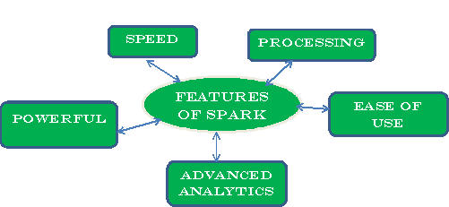
Features of Spark

Slide 5
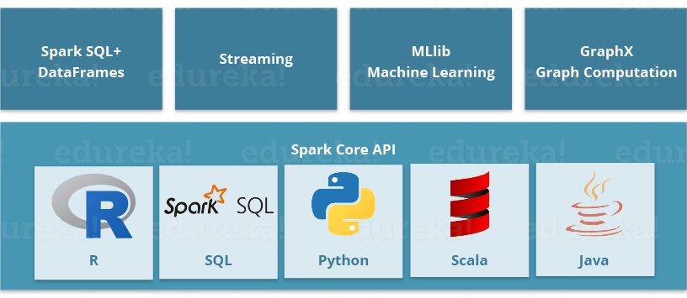
Components of Spark

Slide 6


Hadoop vs Spark
MapReduce processes data in batches only | Spark processes data in batches as well as real-time
Hadoop MapReduce is slower when it comes to Large Scale data processing. | Spark runs almost 100 times faster than Hadoop MapReduce.
Hadoop MapReduce data is stored in HDFS and hence takes a long time to retrieve data. | Spark stores data in the RAM i.e. in memory . So, it is easier to retrieve data.
Hadoop is highly disk-dependent. | Sparking provides caching and in memory storage
Hadoop has more lines of code. Since it is written in Java, it takes more time to execute. | Spark code is easy and it supports 4 languages R, Scala, Python, SQL
It is basic data processing engine. | It is data analytics engine.Hence,it is choice for data scientist.

Slide 7
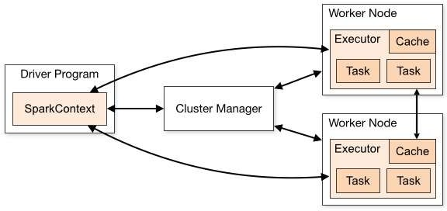
Spark Architecture

Slide 8
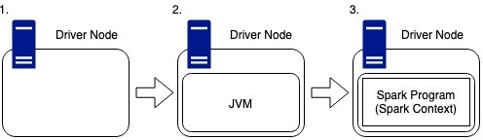
Spark Driver
The Spark driver is used to organize the whole Spark cluster, this means it will manage the work which is distributed across the cluster as well as what machines are available throughout the cluster lifetime.

Slide 9
The driver node is like any other machine, it has hardware such as a CPU, memory, DISKs and a cache, however, these hardware components are used to host the Spark Program and manage the wider cluster.
The Spark Program runs inside of this JVM and is used to create the Spark Context, which is the access point for the user to the Spark Cluster.

Slide 10
Cluster Manager
In the cluster, there is a master and N number of workers.
The prime work of the cluster manager is to divide resources across applications.
It works as an external service for acquiring resources on the cluster.

Slide 11
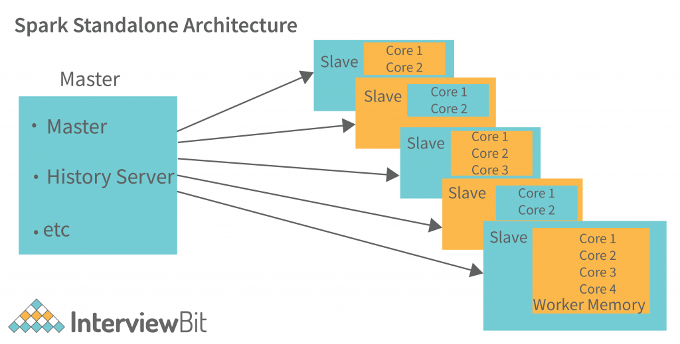
Apache Spark system supports these types of cluster managers
Standalone Cluster Manager:

Slide 12
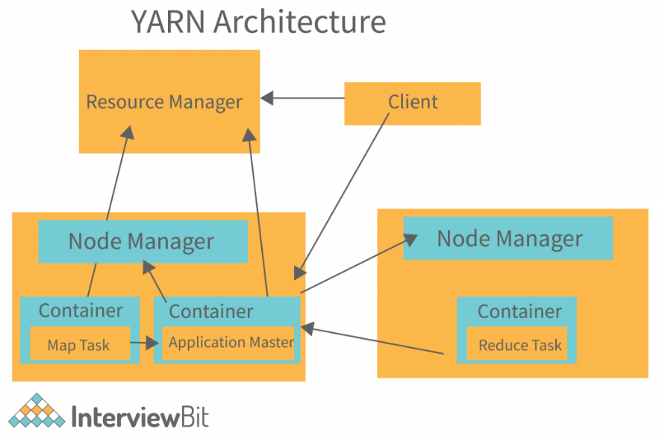
Hadoop Yarn Architecture:

Slide 13
Worker Nodes
Executors or Worker Node refers to node which runs the application code in the cluster.
Worker Node is the Slave Node.
Master node assign work and worker node actually perform the assigned tasks.
Worker node processes the data stored on the node; they report the resources to the master.

Slide 14
The role of worker nodes/executors:
Perform the data processing for the application code
Read from and write the data to the external sources
Store the computation results in memory, or disk.
Executors in Spark are the worker nodes that help in running individual tasks by being in charge of a given spark job.

Slide 15
Task
The single computation unit performed on a single data partition is called a task. It is computed on a single core of the worker node.
In Spark, a Task is the smallest individual unit of execution that corresponds to a RDD partition.
Tasks are launched on executors.

Slide 16
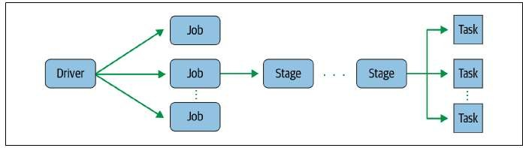
Figure : Tasks correspond to partitions in RDD. In other (more technical) words, a task is a computation on a data partition in a stage of a RDD in a Spark job.

Slide 17
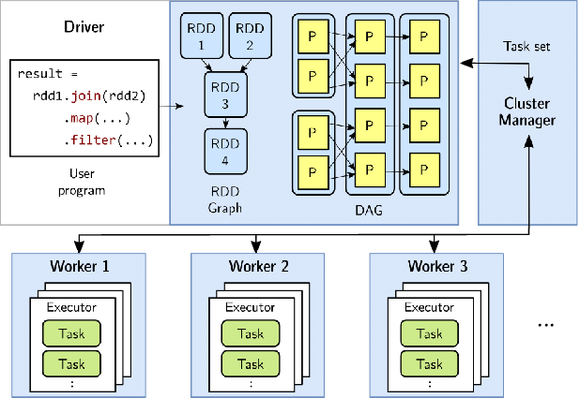

Slide 18
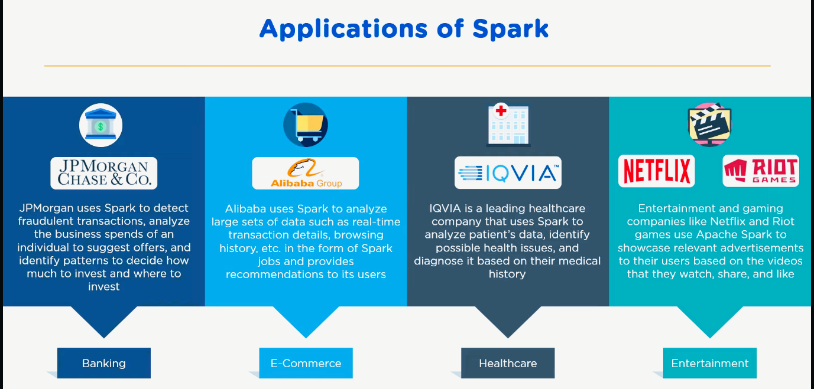
Applications

Slide 19

Presented by
Niranjan Naidu Setha
Data Engineer

